Slide 1

RAG with LlamaIndex
Ravi Theja
Developer Advocate, LlamaIndex
https://github.com/jerryjliu/llama_index

Slide 2

Context
LLMs are a phenomenal piece of technology for knowledge generation and reasoning. They are pre-trained on large amounts of publicly available data.
Use Cases
Question-Answering
Text Generation
Summarization
Planning
LLM’s

Slide 3
















Context
How do we best augment LLMs with our own private data?
Raw Files
API’s
?
Use Cases
Question-Answering
Text Generation
Summarization
Planning
Vector Stores
SQL DB’s
LLM’s

Slide 4
Paradigms for inserting knowledge
Fine-tuning - baking knowledge into the weights of the network
Fine-tune: Private Data
Test
What is DAU as per yesterday’s product brief
1.2M, as per XYZ’s note in Notion
LLM
RLHF
LLM

Slide 5
Paradigms for inserting knowledge
Fine-tuning - baking knowledge into the weights of the network
Downsides:
Data preparation effort
Doesn’t work well
High upfront cost
Online learning/ Updating new data - hard.

Slide 6
Paradigms for inserting knowledge
In-context learning - Fix the model, put context into the prompt
During yesterday's product brief meeting, the team discussed several key metrics, with a focus on Daily Active Users (DAU). Karthik provided an update on the DAU, highlighting that it reached 1.2M, marking a 3% growth compared to last week. The team attributed this growth to the recent updates in the onboarding process and expressed optimism for continued upward trends………….
Test
What is DAU as per yesterday’s product brief, given following docs
1.2M, as per XYZ’s note in Notion
+
LLM
Prod Brief
Meeting Notes

Slide 7
Paradigms for inserting knowledge
In-context learning - Fix the model, put context into the prompt
Downsides:
Model token limit on context length.
Right context might

Slide 8
Key challenges of in-context learning
How to retrieve the right context for the prompt?
How to deal with long context?
How to deal with source data that is potentially very large? (GB’s, TB’s)
How to tradeoff between:
Performance
Latency
Cost

Slide 9




LlamaIndex
Knowledge-Intensive LLM Applications
Sales
Marketing
Recruiting
Dev
Legal
Finance
…
Input: rich query description
Output: rich response with references, actions, etc
LlamaIndex
Data framework for LLM app development
Foundation Models

Slide 10
LlamaIndex: A data framework for LLM applications
Data Management and Query Engine for your LLM application
Offers components across the data lifecycle: ingest, index, and query over data
Data Ingestion (LlamaHub 🦙)
Data Structures
Retrieval and Query Interface
Connect your existing data sources and data formats (API’s, PDF’s, docs, SQL, etc.)
Store and index your data for different use cases. Integrate with different db’s.
Given an input prompt, retrieve relevant context and synthesize a knowledge-augmented output.

Slide 11
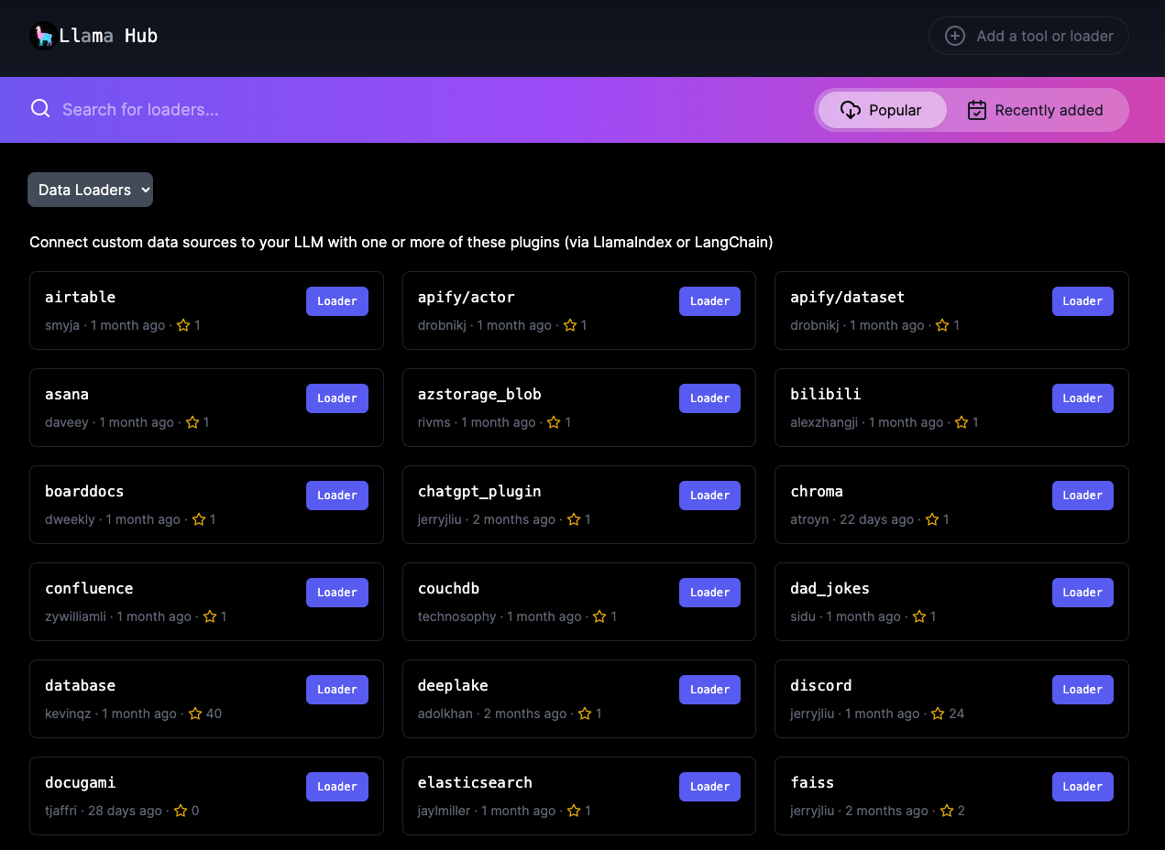
LlamaIndex:
First Abstractions: Data Ingestion (LlamaHub)
LlamaHub
Data Loaders
Documents
100+ Data Loaders in LlamaHub

Slide 12
LlamaIndex:
First Abstractions - Indexing
Indexing:
Document (text) is split into multiple chunks and embedding for each chunk is created.
Chunk + Embedding is abstracted as Node.
All nodes are stored in in-memory index or Vector DB.
Document from different sources are broken down as per settings
Node1
Node2
Node3
In-memory Index/ Vector DB
CHUNK-1
EMBEDDING-1
CHUNK-2
EMBEDDING-2
CHUNK-3
EMBEDDING-3
Works with different vector DB’s such as Pinecone, Weaviate, Qdrant.

Slide 13
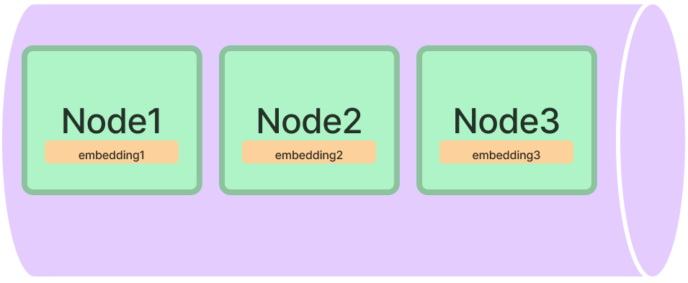
Vector Store Index
Raw Documents
Stored as Nodes in a vector store
Each Node is indexed with an embedding
Doc
Vector Store
Node1
Node2
Node3
Embedding1
Embedding2
Embedding3

Slide 14
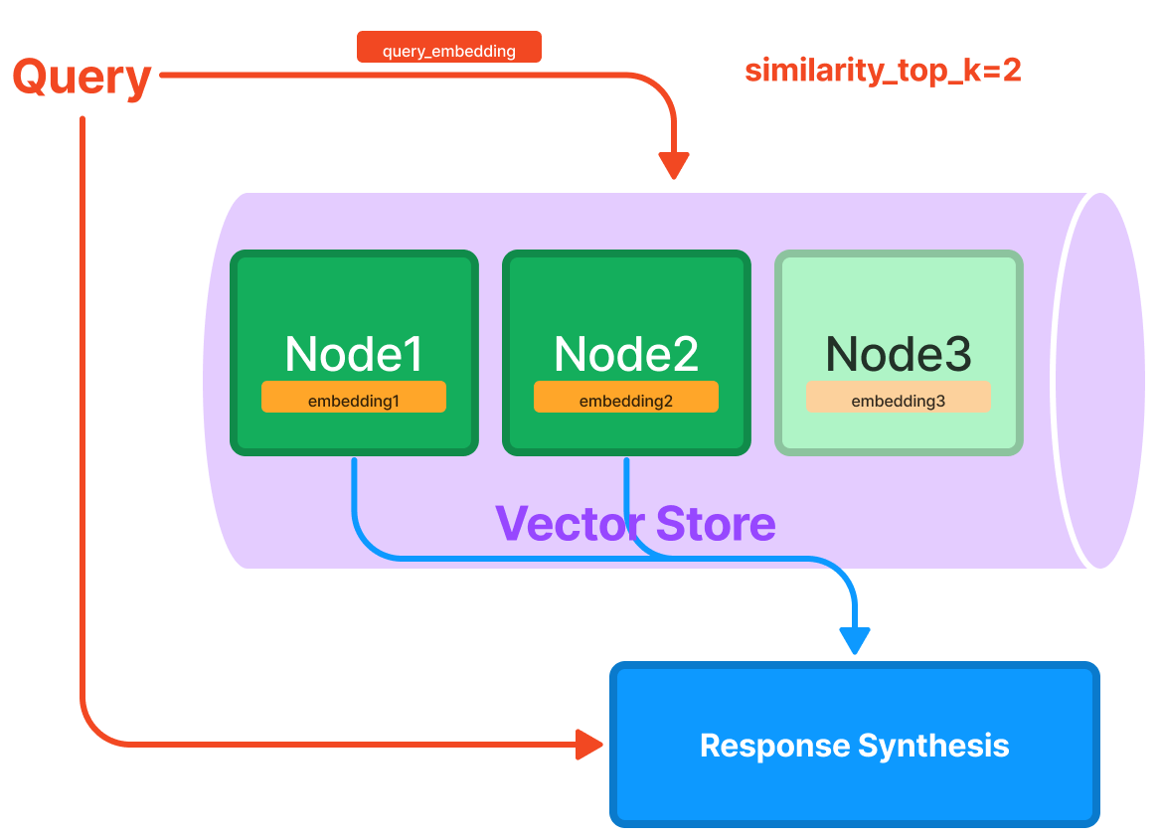
LlamaIndex:
First Abstractions - Retrieval
When user asks a query.
It retrieves the nodes and ranks them based on embedding similarity between query and nodes.
Post-process the retrieved nodes if needed.
Directs the retrieved nodes to Response Synthesis module.

Slide 15
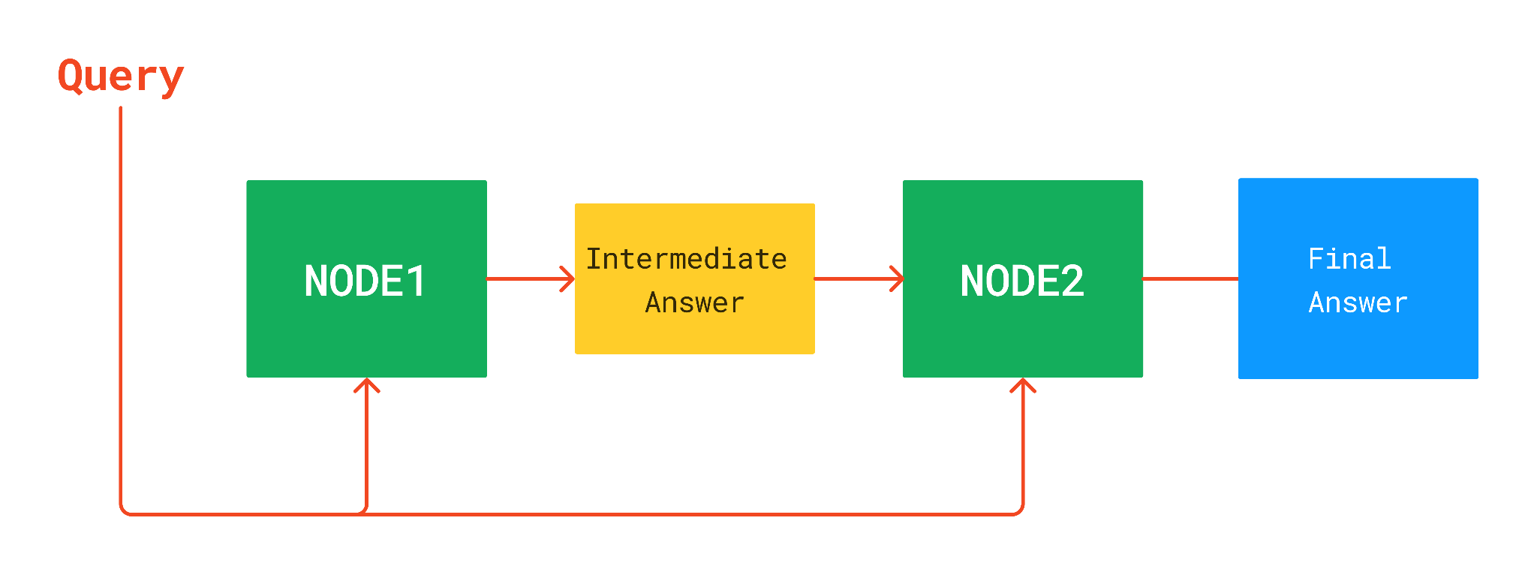
LlamaIndex:
First Abstractions - Response Synthesis

Slide 16

Data Indices + Query Interface
Your source documents are stored in a data collection
In-memory, MongoDB
Our data indices help to provide a view of your raw data
Vectors, keyword lookups, summaries
A retriever helps to retrieve relevant documents for your query
A query engine manages retrieval and synthesis given the query.

Slide 17
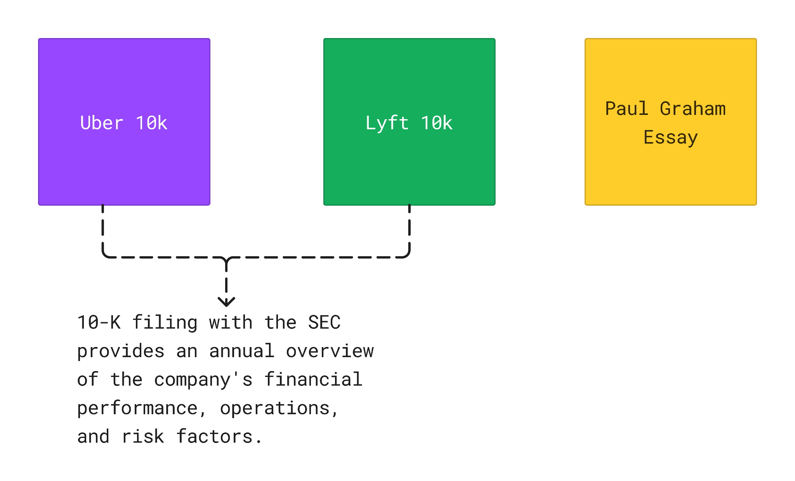
Documents

Slide 18
Semantic Search
from llama_index import VectorStoreIndex, SimpleDirectoryReader
documents = SimpleDirectoryReader('data').load_data()
index = VectorStoreIndex.from_documents(documents)
query_engine = index.as_query_engine()
response = query_engine.query(
"What is the revenue of uber in 2021?"
)
Answer
17,455 million

Slide 19
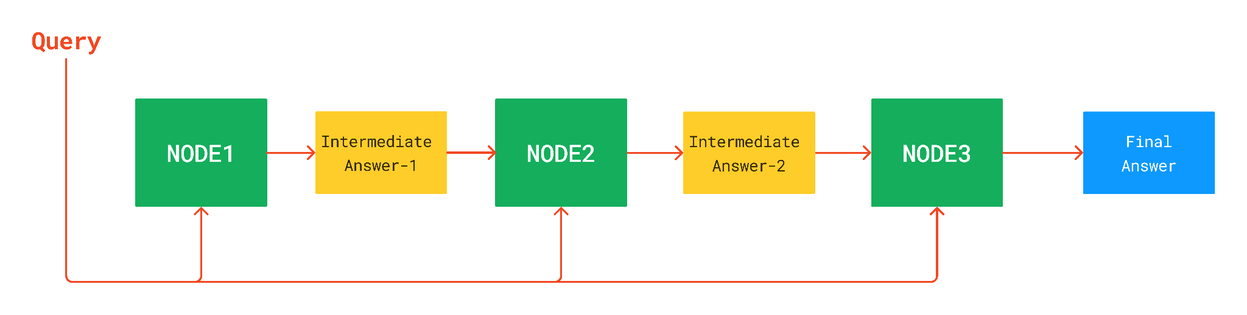
Summarization - SummaryIndex

Slide 20
Summarization
from llama_index import SummaryIndex, SimpleDirectoryReader
documents = SimpleDirectoryReader('data').load_data()
index = SummaryIndex.from_documents(documents)
query_engine = index.as_query_engine()
response = query_engine.query("Provide the summary.")
Answer
The author began writing and programming before college, and studied philosophy in college before switching to AI.
He realized that AI, as practiced at the time, was a hoax and decided to focus on Lisp hacking instead.
He wrote a book about Lisp hacking and graduated with a PhD in computer science.
….

Slide 21
Building RAG with LlamaIndex
PRACTICAL SESSION - 1

Slide 22
BREAK - 15 minutes

Slide 23
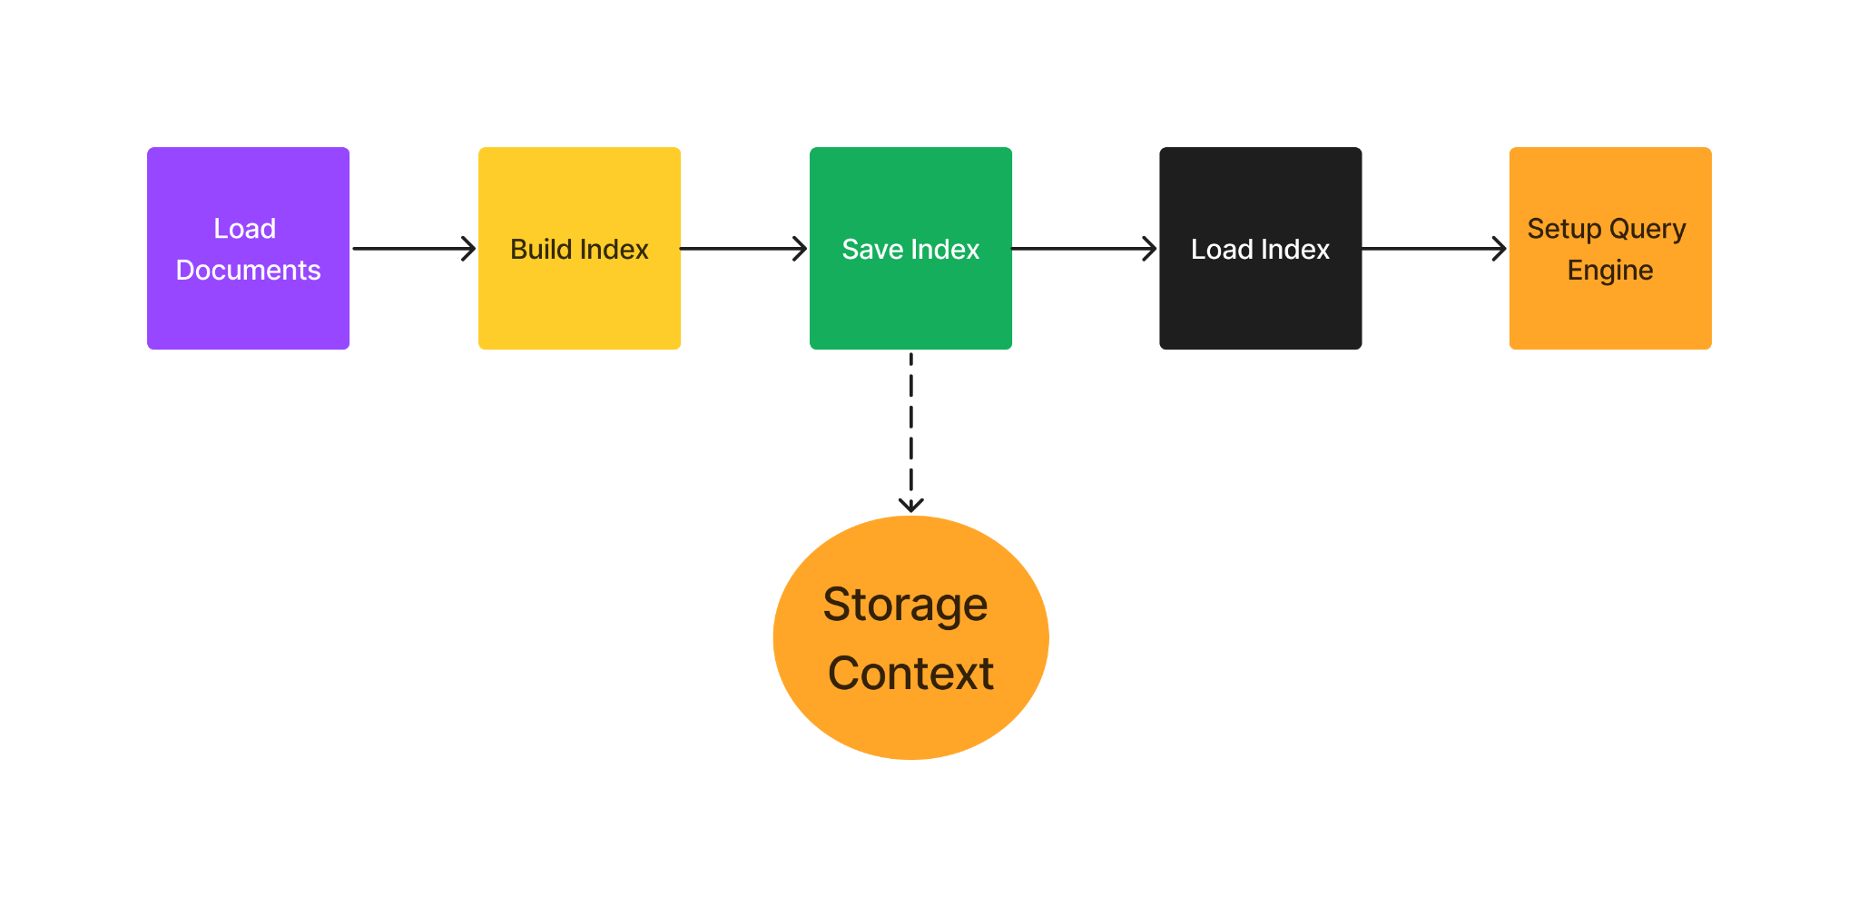
Saving And Loading the index

Slide 24
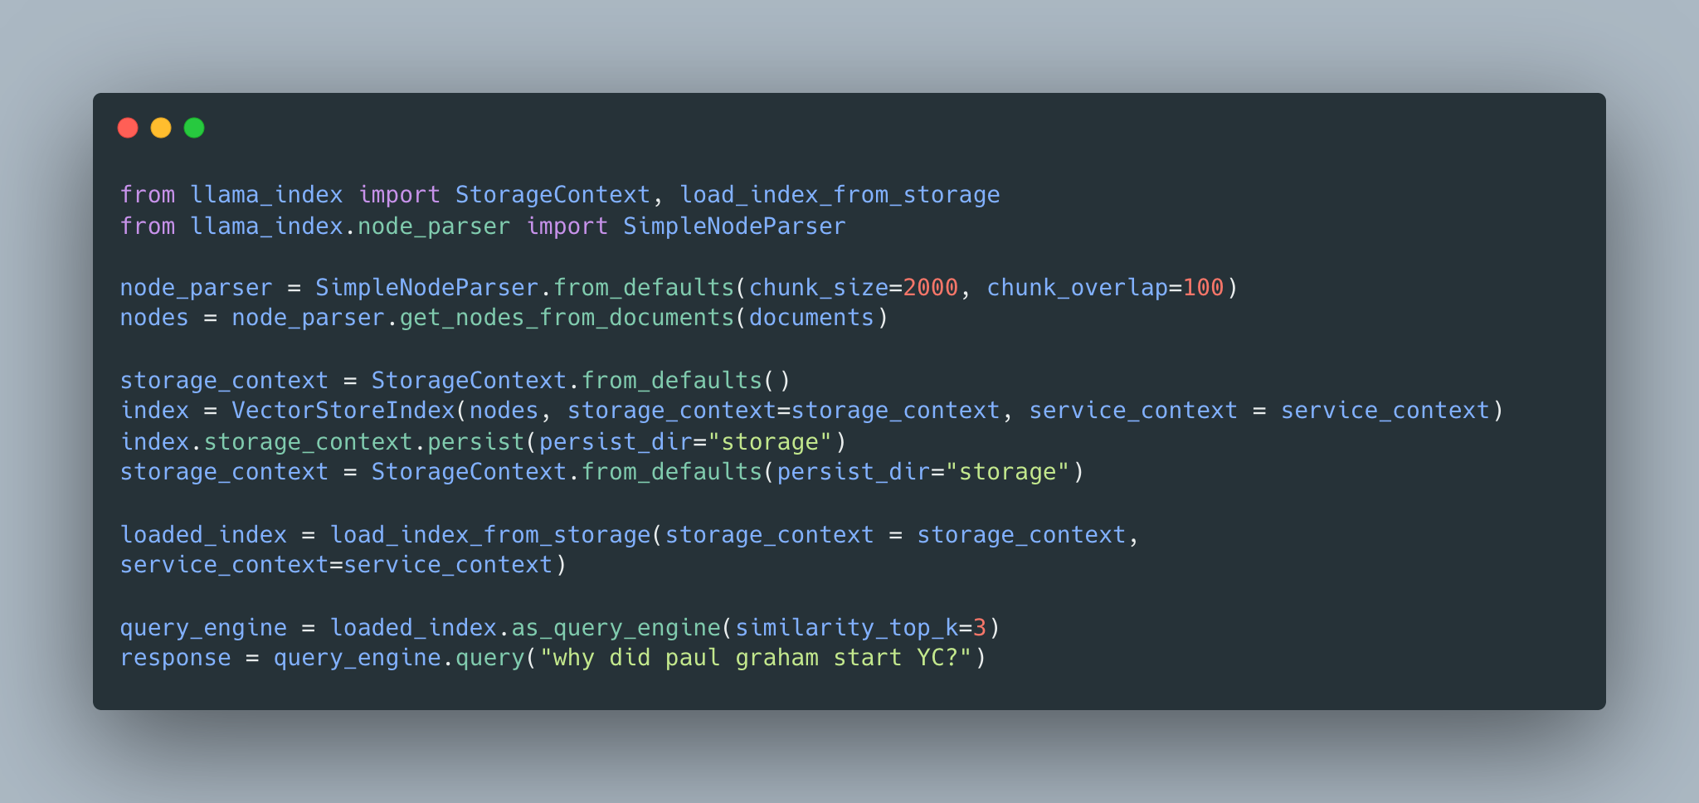

Slide 25
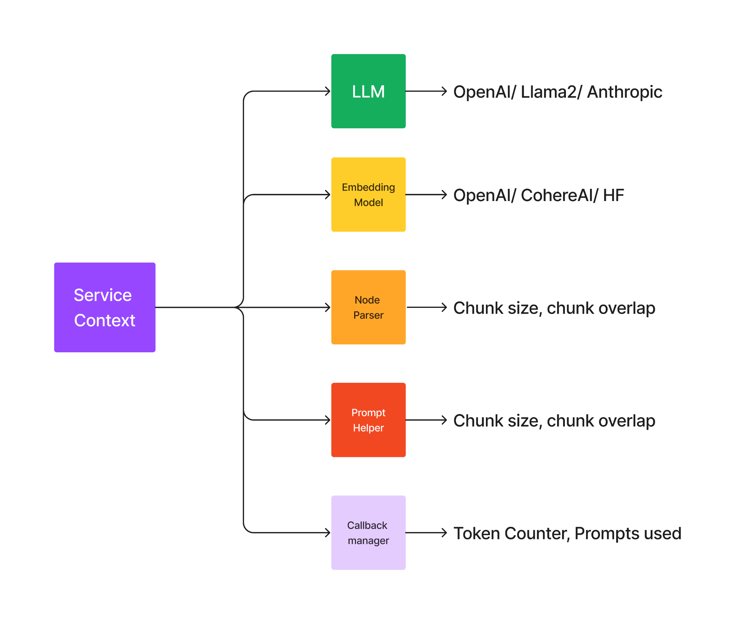
Customizing LLM, Embeddings, Nodes

Slide 26
Customize RAG with LlamaIndex
PRACTICAL SESSION - 2

Slide 27
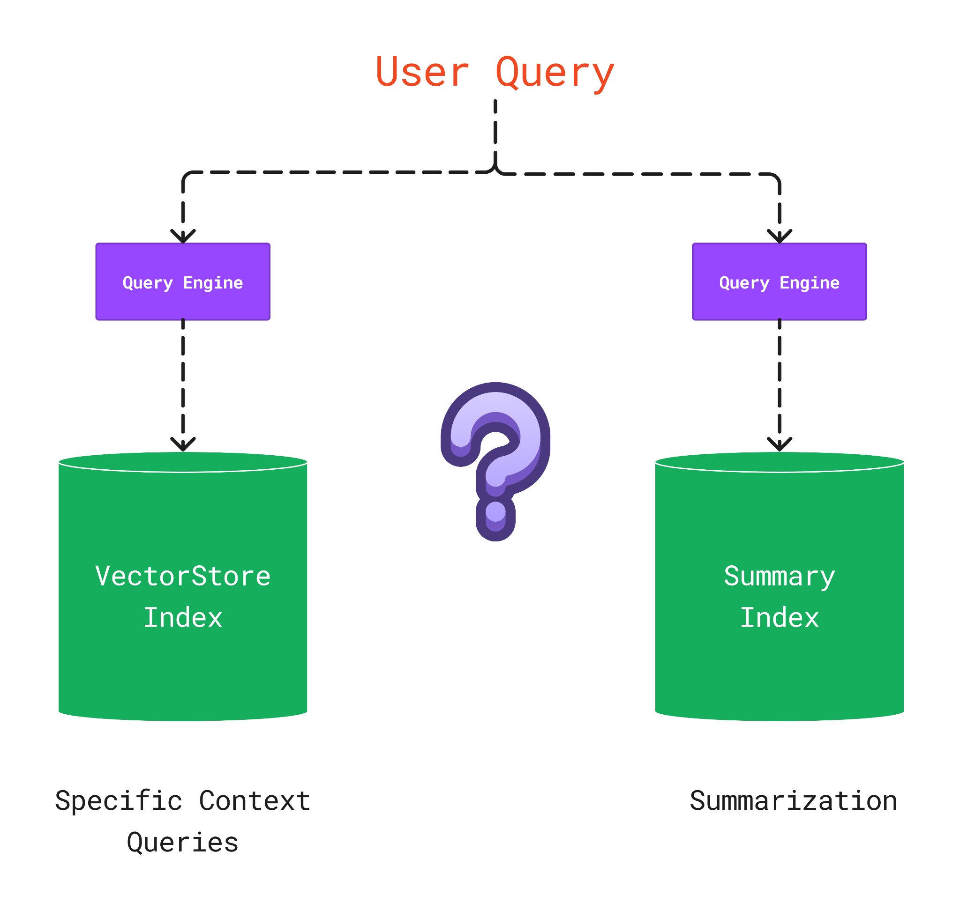
Which Index to query?

Slide 28
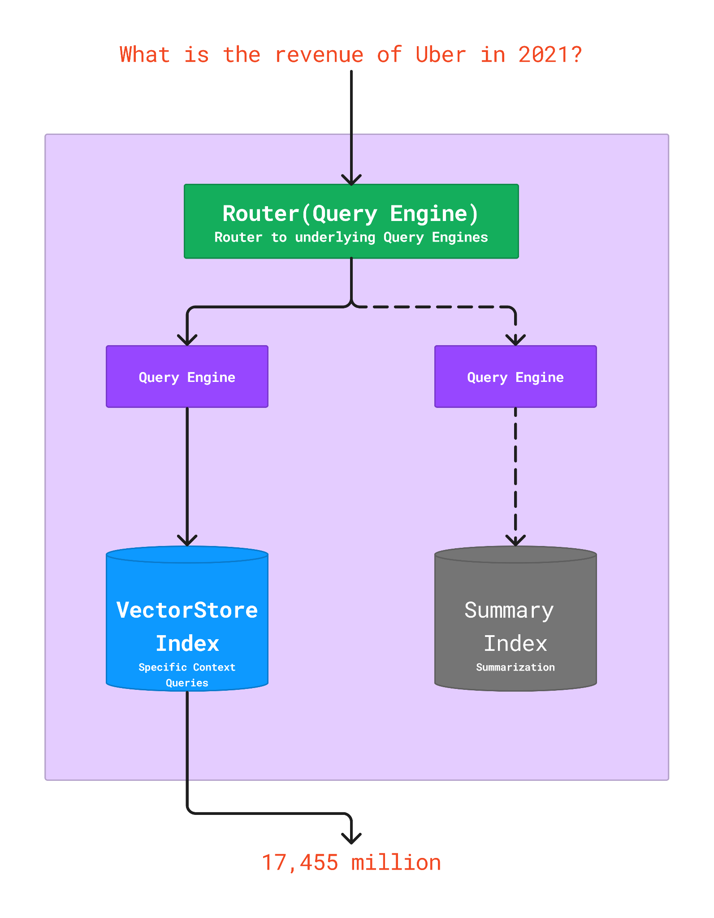
Building a Unified Query Interface
Can use a “Router” abstraction to route to different query engines.
For instance, can do joint semantic search / summarization

Slide 29
Router Query Engine
PRACTICAL SESSION - 3

Slide 30
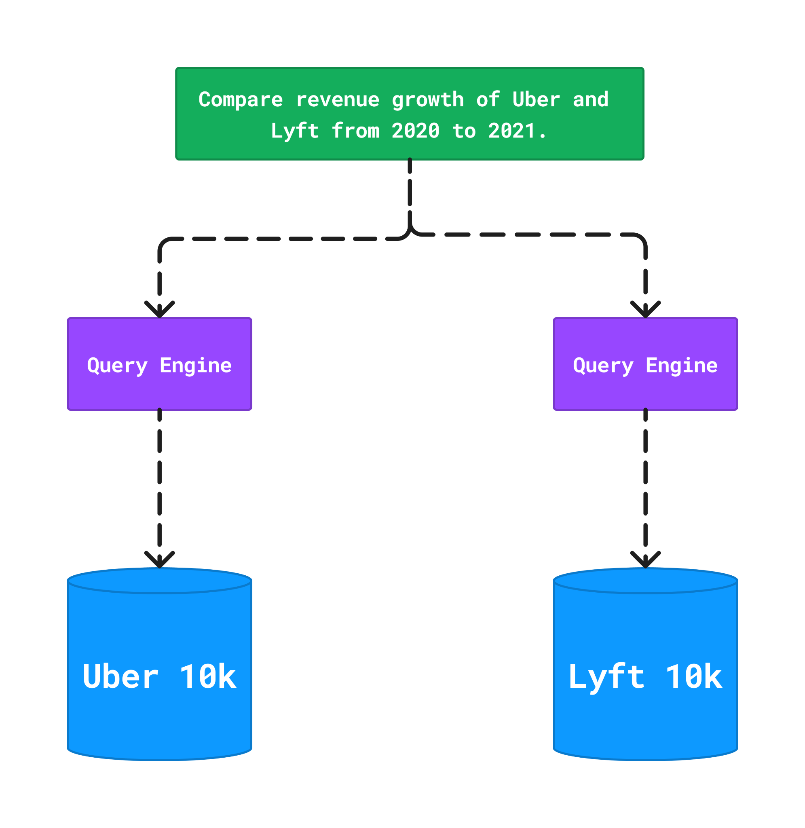
Document Comparisons

Slide 31
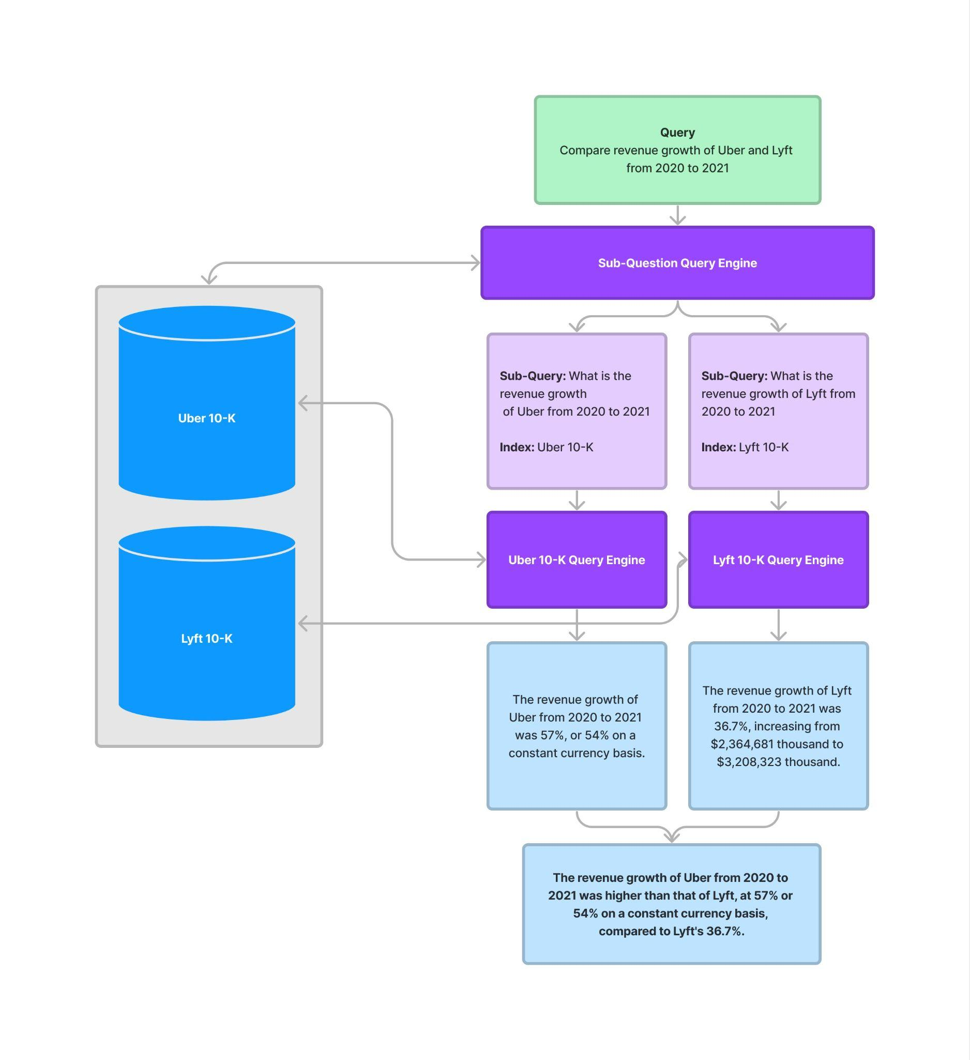
Document Comparisons
Say you want to compare the 2021 10-K filings for Uber and Lyft
Question: “Compare and contrast the customer segments and geographies that grew the fastest.”
Generate a query plan over your document sources.

Slide 32
Sub Question Query Engine
PRACTICAL SESSION - 4

Slide 33
BREAK - 15 minutes

Slide 34
Metadata Management
PRACTICAL SESSION-5

Slide 35
Document Agents with Recursive Retriever
PRACTICAL SESSION - 7

Slide 36
Evaluation
Response Evaluation.
FaithFullNess Evaluator - to measure if the response is hallicunated.
Relevancy Evaluator - to measure if the response + source nodes match the query.
Correctness Evaluator - to evaluate the relevance and correctness of a generated answer against a reference answer.
Guideline Evaluator - to evaluate a question answer system given user specified guidelines.
GUIDELINES = [
"The response should fully answer the query.",
"The response should avoid being vague or ambiguous.",
"The response should be specific and use statistics or numbers when possible.",
]

Slide 37
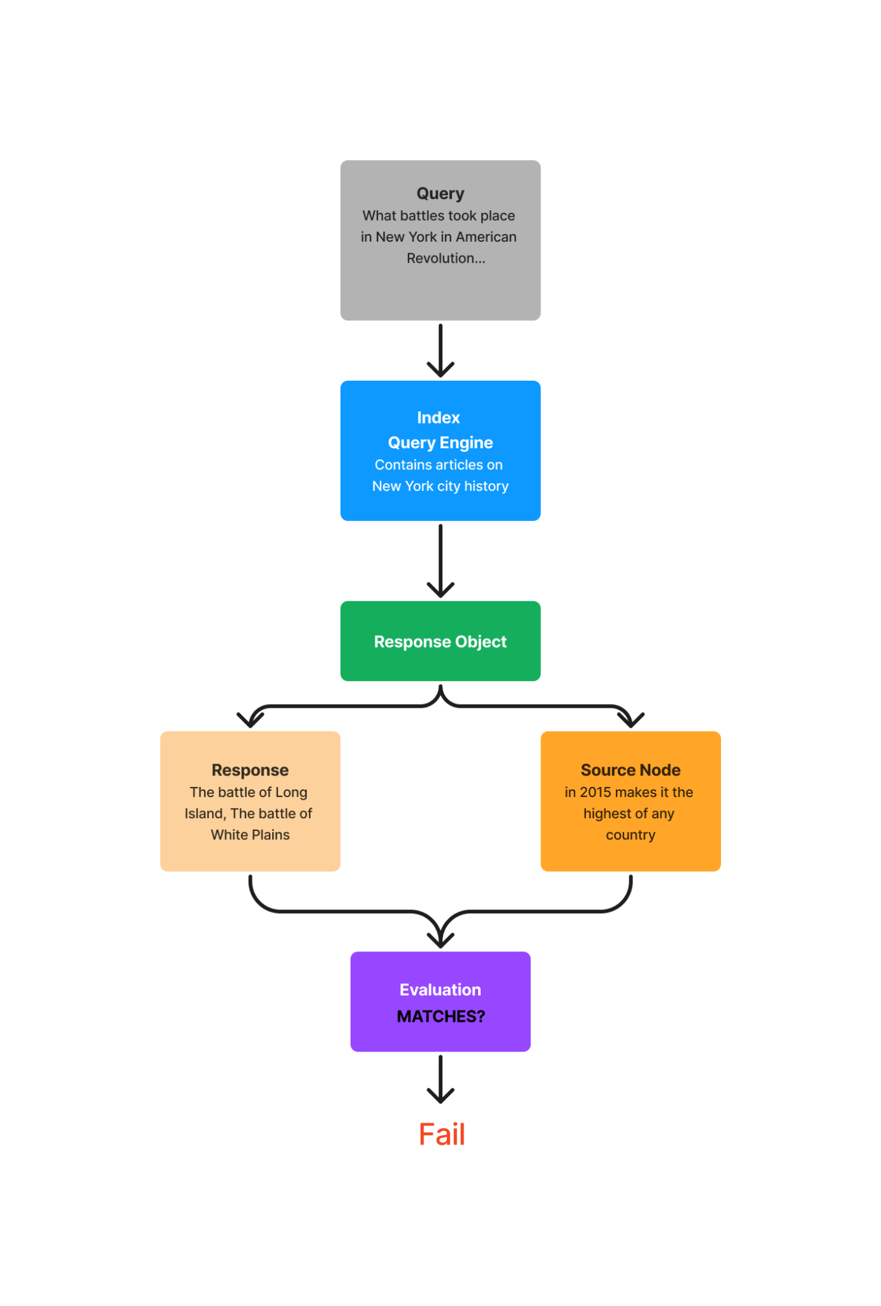
FaithFullness Evaluator

Slide 38
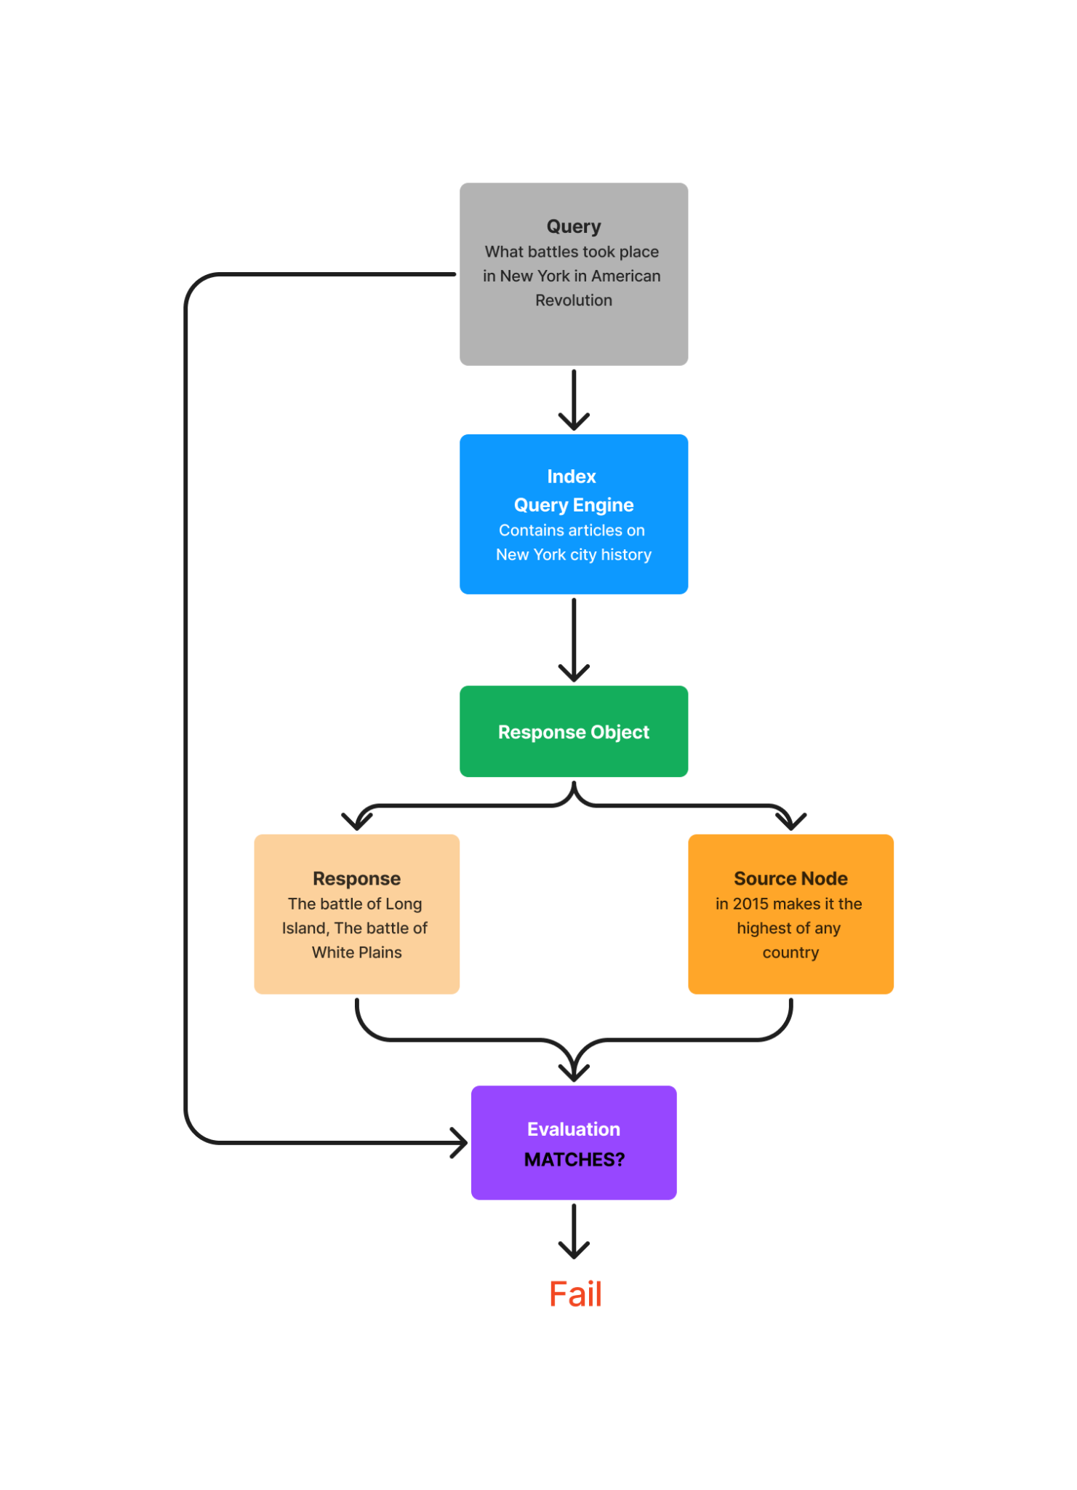
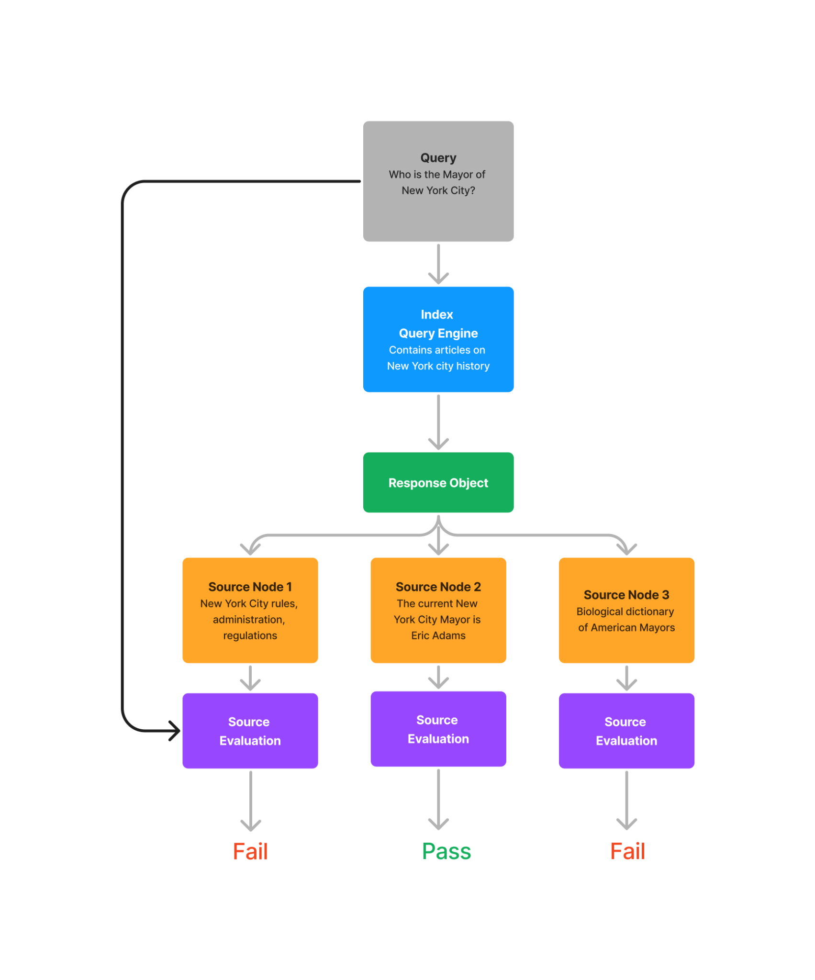
Relevancy Evaluator

Slide 39
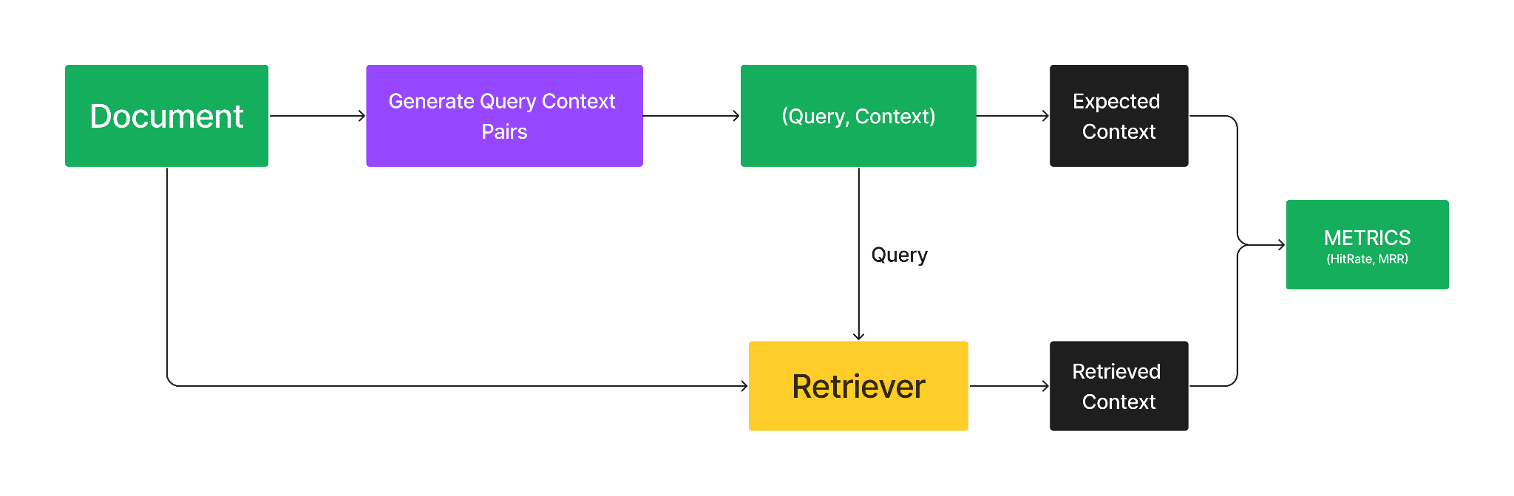
Evaluation
Retrieval Evaluation.
Hit Rate.
MRR
Evaluation guide: https://gpt-index.readthedocs.io/en/stable/core_modules/supporting_modules/evaluation/root.html

Slide 40
Evaluation
PRACTICAL SESSION - 6

Slide 41
Fine-tuning Embedding Models

Slide 42
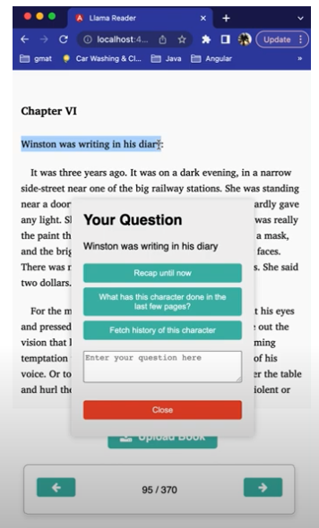
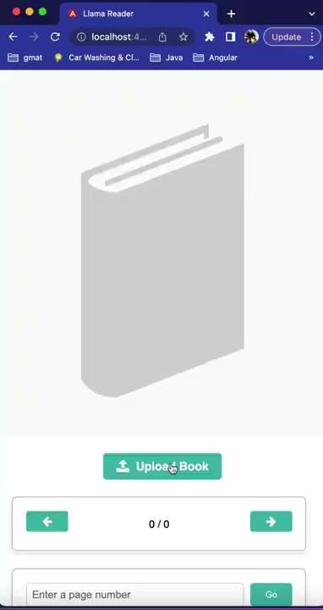
Applications Using LlamaIndex
LlamaReaders

Slide 43
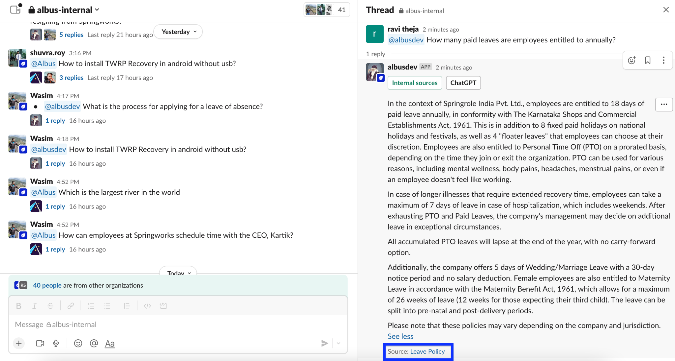
Albus
Demo

Slide 44
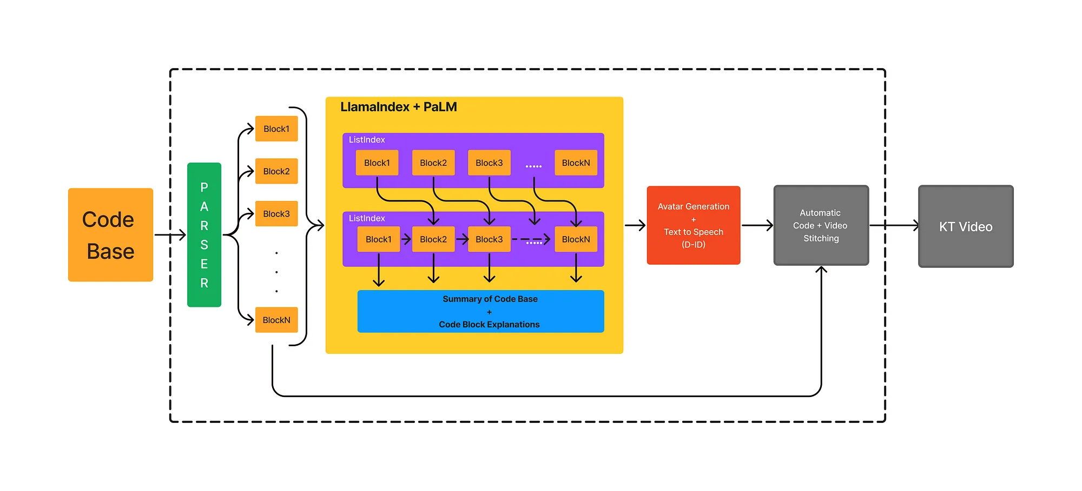
Automatic KT Generator For Code Bases
Video
Blog Post

Slide 45
Guides
BlogPost/ Project
BlogPost/ Project Submission
Documentation Guide.
Contributions Guide.
Discord.
Twitter.
Linkedin.

Slide 46
Thanks!
Linkedin to reach out.
BlogPost/ Project Submission

Slide 47

Win T-Shirts by Participating In Quiz

